Slide 1
Plant, Soil and Weed Identification
Grad Team 6
Jagadeesh Puvvula, Sriram Srinivasan, Thallon Pitchure

Slide 2
Preprocess the RGB data
Simplified the given data
Set Image size
Convert to grayscale
Set Classification Categories (1-3)
Note: Converting RGB to hexadecimal value is a terrible idea

Slide 3
Data Augmentation & Batch Size
Horizontal Flip
Rotation
Rescale
Sheer Range
Echo:- 10-150
Batch Size:- 10-16

Slide 4
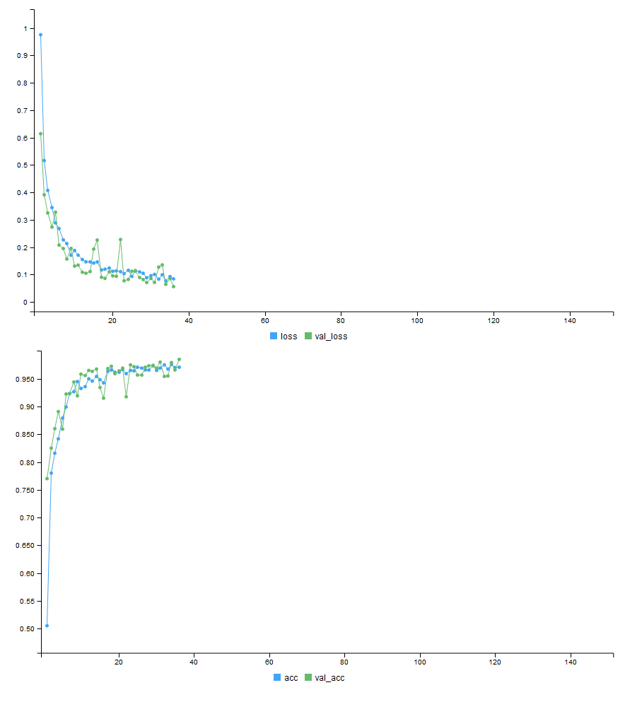
Final Predictions
Using the Keras package we generated approx 98.33% accuracy with initial Kaggle submission
Xception Model took time 48 hours (including Tuning)

Slide 5
Thank You!

